Slide 1

DATA Get Conversational
The Art of Possible with Azure Data

Slide 2
The Art of Possible with Azure Data
Digital Transformation imperatives with data
Successful Customer case studies
Azure Data Platform
Data modernization on-premises and in the Cloud
Cloud Scale Analytics
Key technology components

Slide 3




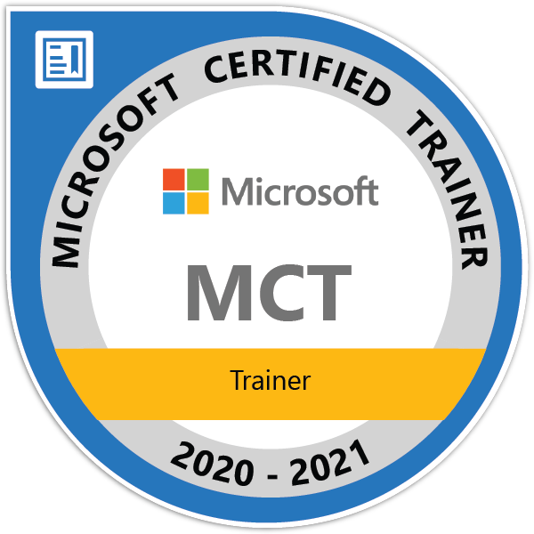

STEFANO TEMPESTA
/in/stefanotempesta
@stefanotempesta

Slide 4

Digital Transformation imperatives with data

Slide 5
The age of data abundance
Consumers both generate and use data
Business stakeholders use data to make business decisions
Consumers use data to make decisions such as what to buy and where to travel to
Data can be structured, unstructured, or aggregated
Data systems must be accurate, highly secure, and constantly available
Notes:
https://docs.microsoft.com/en-us/learn/modules/evolving-world-of-data/

Slide 6

Survey the data storage options in Azure
Discover how Azure data storage can meet your business demands
Compare Azure data storage with on-premises storage

Slide 7
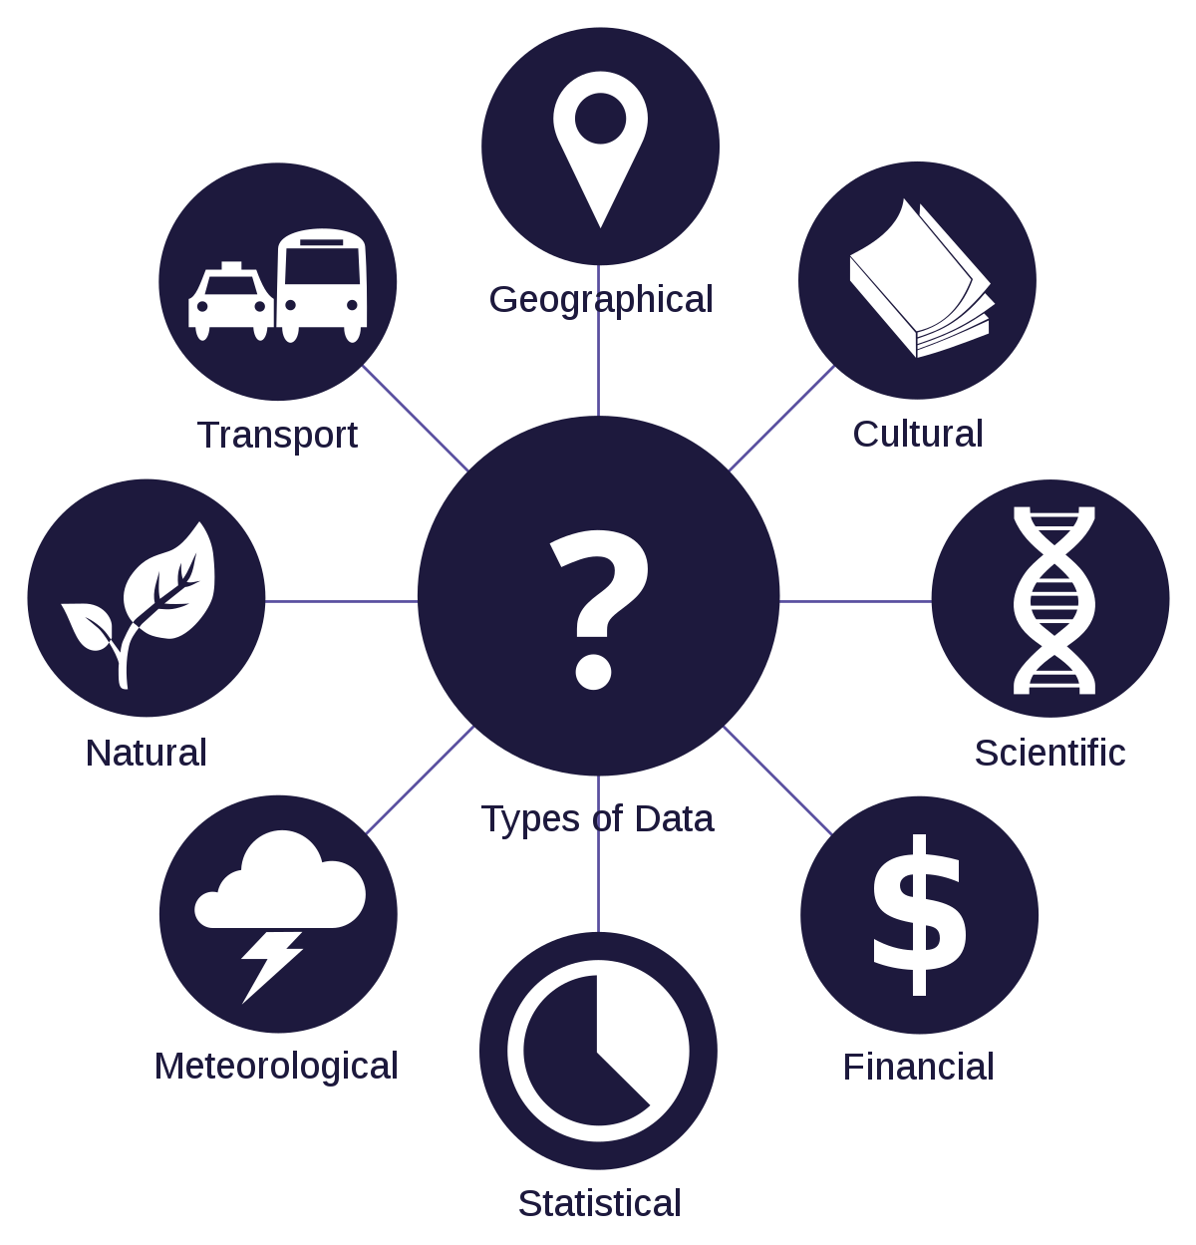
Types of data
Structured data
Semi-structured data
Unstructured data
Notes:
https://docs.microsoft.com/en-us/learn/modules/intro-to-data-in-azure/

Slide 8

On-premises environments
Computing environment
Licensing
Maintenance
Scalability
Availability
Support
Total cost of ownership

Slide 9
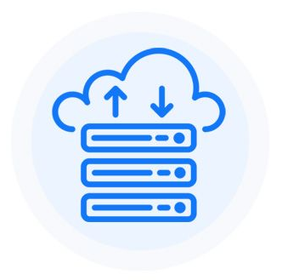
Cloud environments
Computing environment
Maintenance
Scalability
Availability
Support
Total cost of ownership
Lift and shift

Slide 10
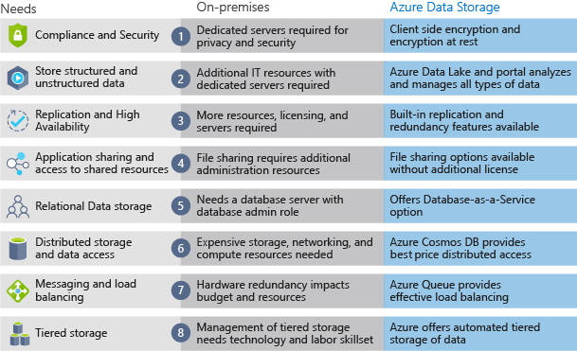
On-premises or Cloud?

Slide 11

Store data in the Azure Cloud
Automated backup and recovery
Replication across the globe
Support for data analytics
Encryption capabilities
Multiple data types
Data storage in virtual disks
Storage tiers
Notes:
https://docs.microsoft.com/en-us/learn/paths/store-data-in-azure/

Slide 12

Governance
Roles & responsibilities
Change data processes
From implementing to provisioning
Operational needs
Notes:
https://docs.microsoft.com/en-us/learn/modules/evolving-world-of-data/4-understand-job-responsibility
https://docs.microsoft.com/en-us/learn/modules/choose-storage-approach-in-azure/3-operations-and-latency

Slide 13

Successful Customer case studies

Slide 14
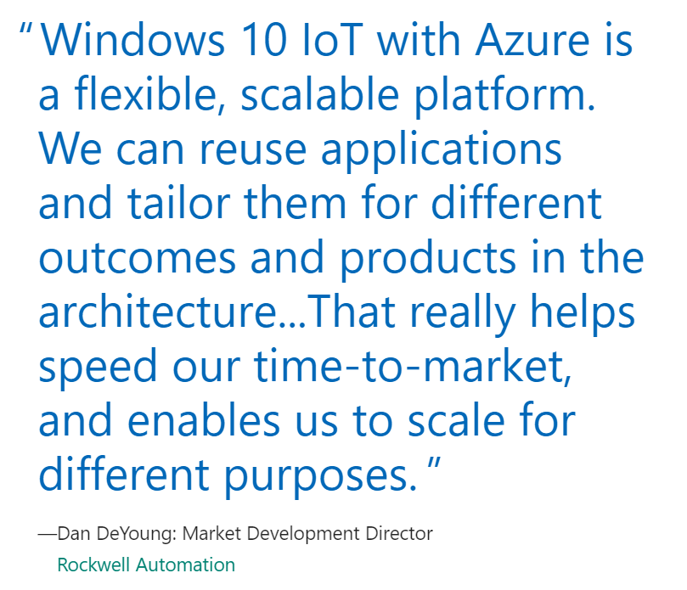
Accelerate time to market
Rockwell Automation
Designing an IT platform for manufacturing processes
Gaining real-time insight into operational processes
Simplifying the adoption of advanced analytics
https://customers.microsoft.com/en-au/story/rockwell-automation
Notes:
https://azure.microsoft.com/en-au/solutions/data-warehouse/

Slide 15


Productive
Rockwell cut development time by 80% for shorter time-to-market, reduced costs, and improved customer responsiveness
Best in class support for SQL, Apache Spark, and Apache Hadoop, and large developer community support
Provision your data warehouse and spark environment in minutes with a single click
Accelerate your data integration with consistent 30+ native data connectors
Empower your data scientists, data engineers, and business analysts to use the tools and languages of their choice

Slide 16
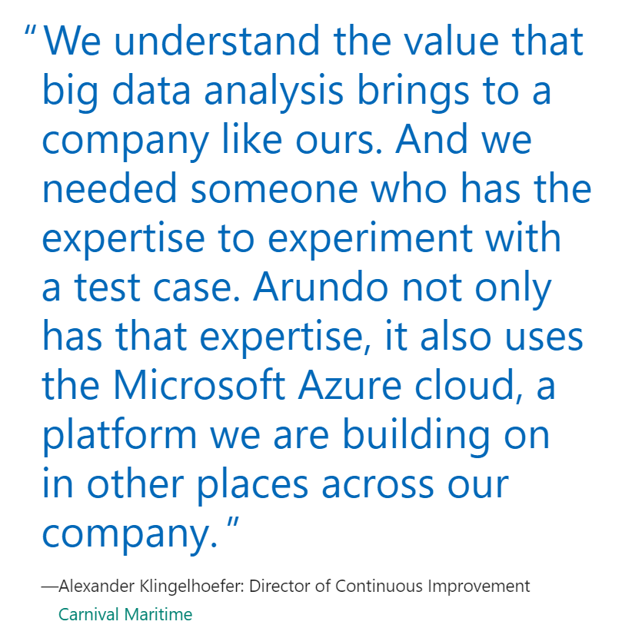
Solution based on specific needs
Carnival Maritime
Churning an ocean of data
Keeping track of the consumption of water
Scanning the horizon
https://customers.microsoft.com/en-au/story/carnivalmaritime
Notes:
https://azure.microsoft.com/en-au/solutions/data-warehouse/

Slide 17



Hybrid
Hybrid solution predicts onboard water usage saving $200k/ship/year
Leverage SQL Server’s proven performance and security consistently, in the public or private cloud
Reduce cost and complexity of managing your existing data transformations by consistently running SQL Server Integration Service packages in Azure
Enable consistent user experience with a common identity across on-premises and Azure

Slide 18
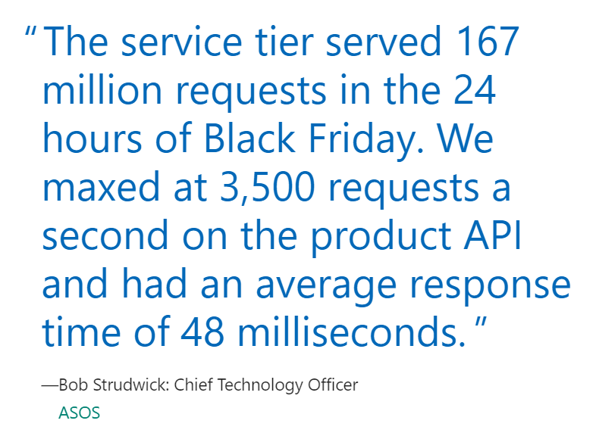
Get insights on any data
ASOS
Keeping up with business growth and marketplace trends
Transforming with cloud-based microservices
Delivering a more personalized, mobile-first experience
https://customers.microsoft.com/en-au/story/asos
Notes:
https://azure.microsoft.com/en-au/solutions/data-warehouse/

Slide 19


Intelligent
ASOS delivers 13 million personalized experiences with 33 orders per second
ASOS delivers 13 million personalized experiences with 33 orders per second
Build and deploy machine learning models on premises, in the cloud, or on the edge
Leverage the data science tool of your choice with support for the best of Microsoft and open source innovation
Gain insights right from your database with in-database analytics
Easily distribute insights across your organization through rich integration with Power BI and other leading BI tools

Slide 20

Azure Data Platform

Slide 21
Azure Data Platform
Easily build and deploy anywhere
Create an impact using an open platform
Develop apps with built-in intelligence
Notes:
https://azure.microsoft.com/en-au/overview/data-platform/
https://docs.microsoft.com/en-us/learn/modules/survey-the-azure-data-platform/

Slide 22
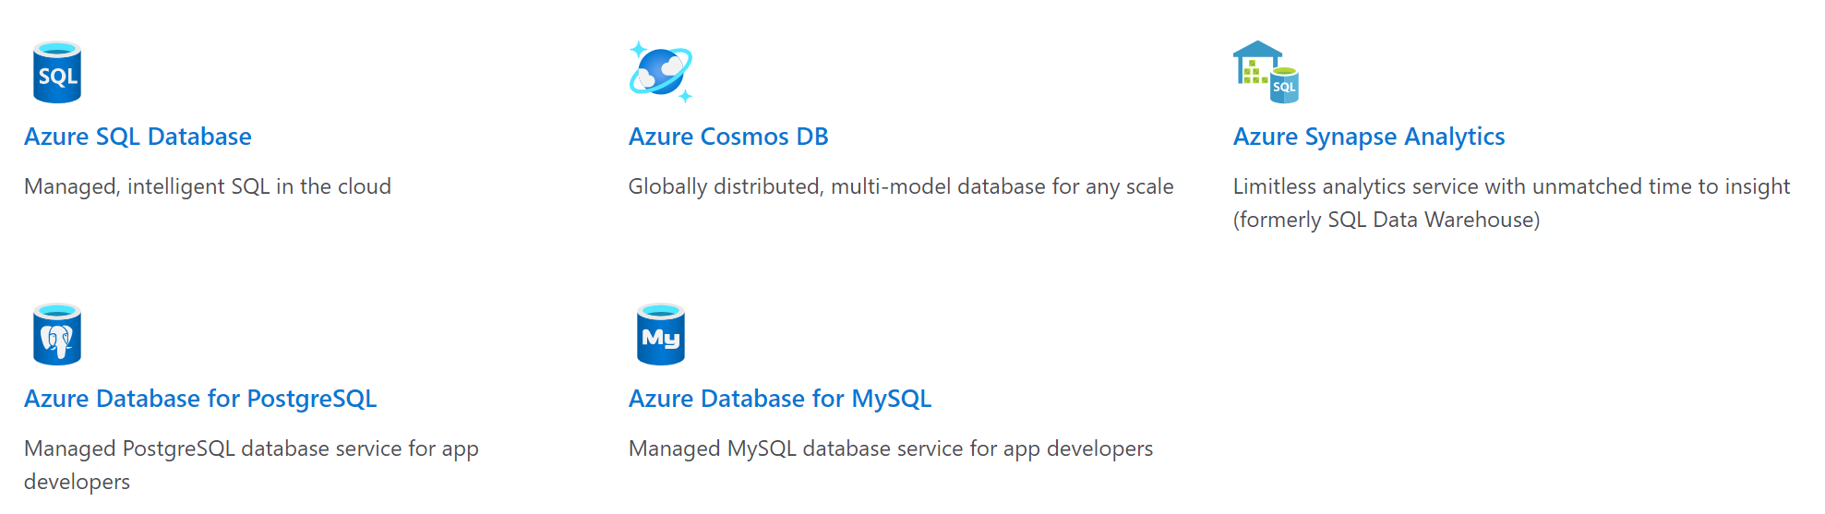
Databases

Slide 23
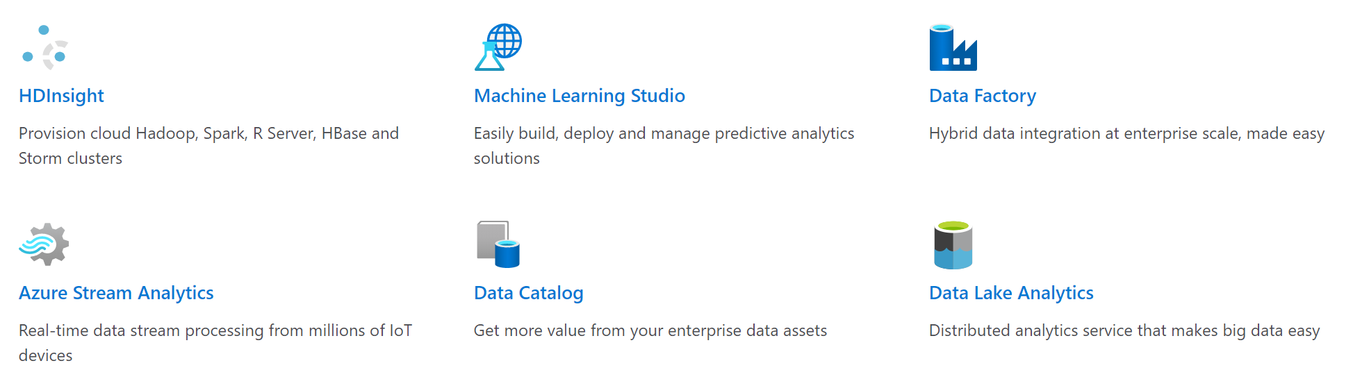
Analytics

Slide 24
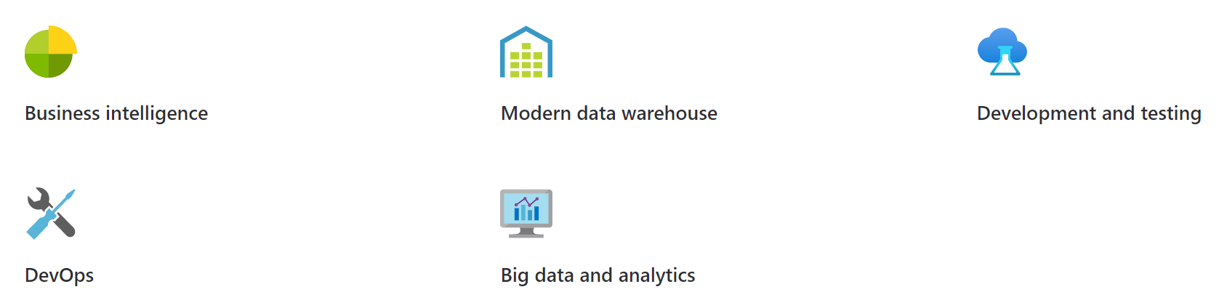
Solutions

Slide 25
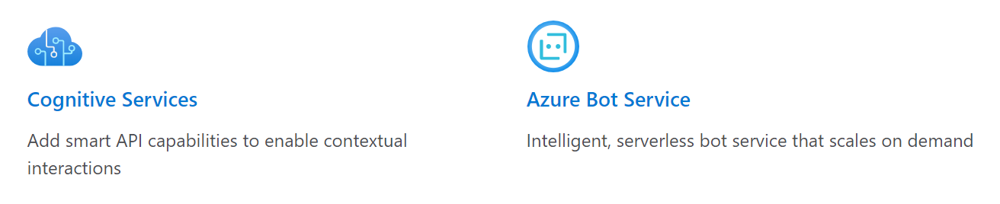
Related services

Slide 26
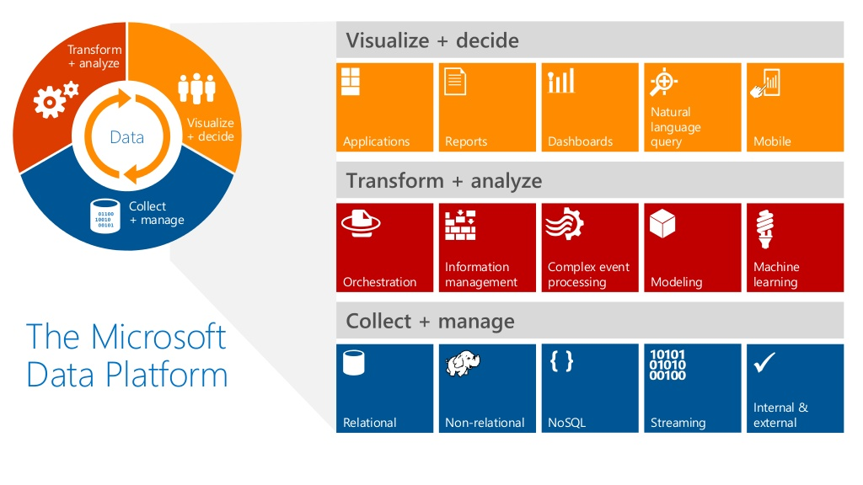

Slide 27
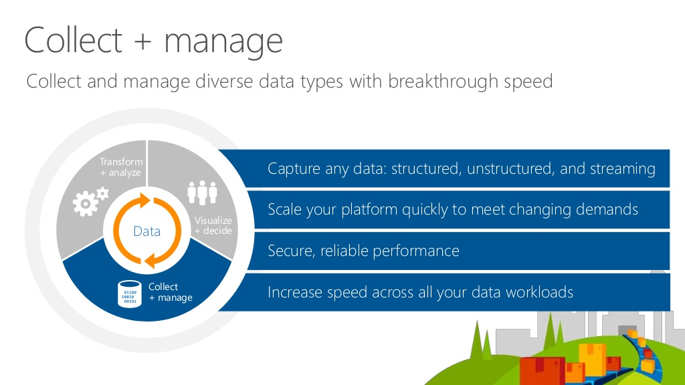

Slide 28
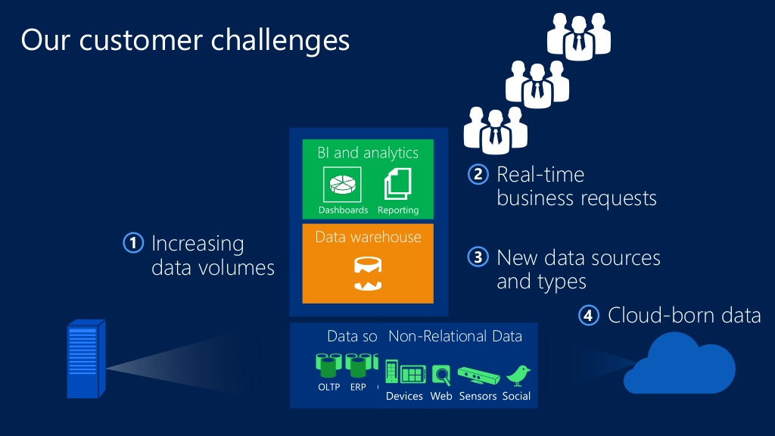

Slide 29
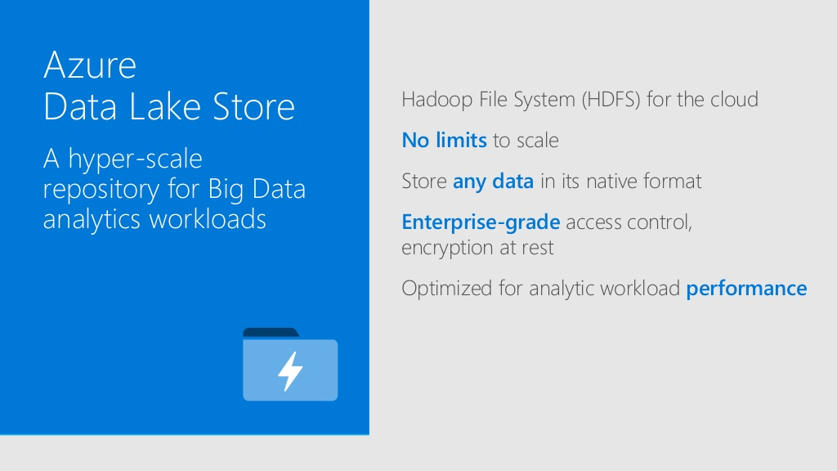

Slide 30
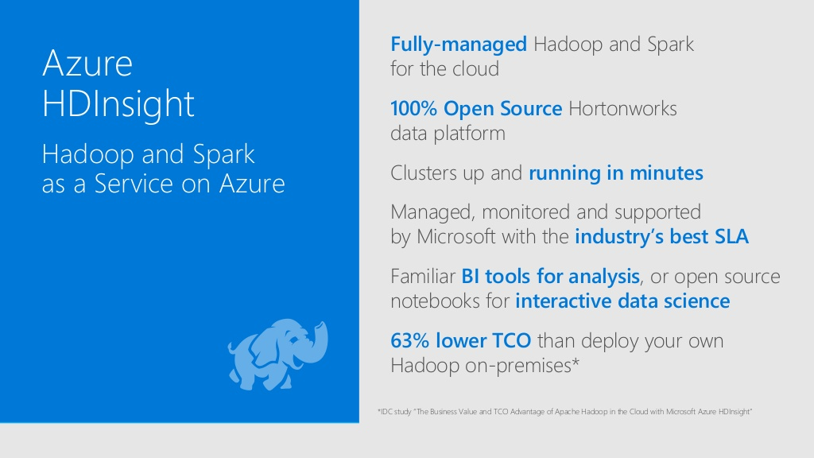

Slide 31
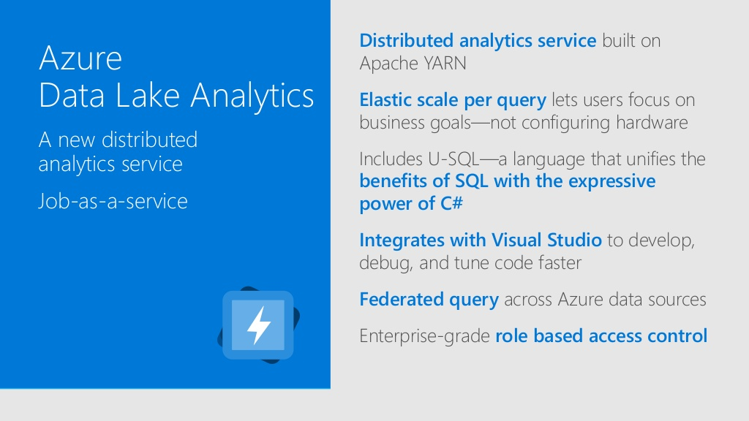

Slide 32
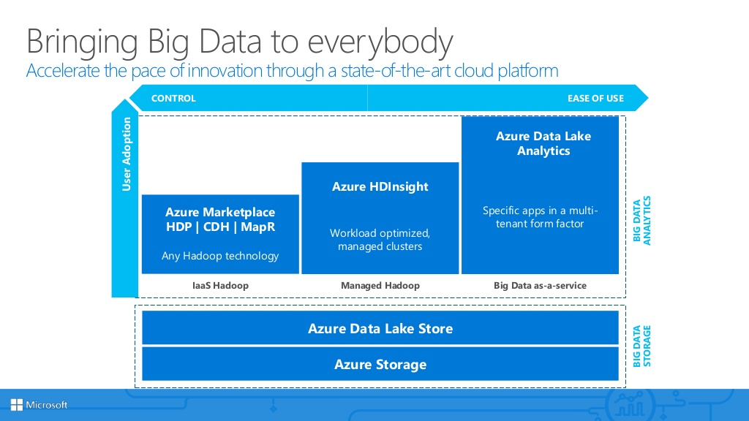

Slide 33
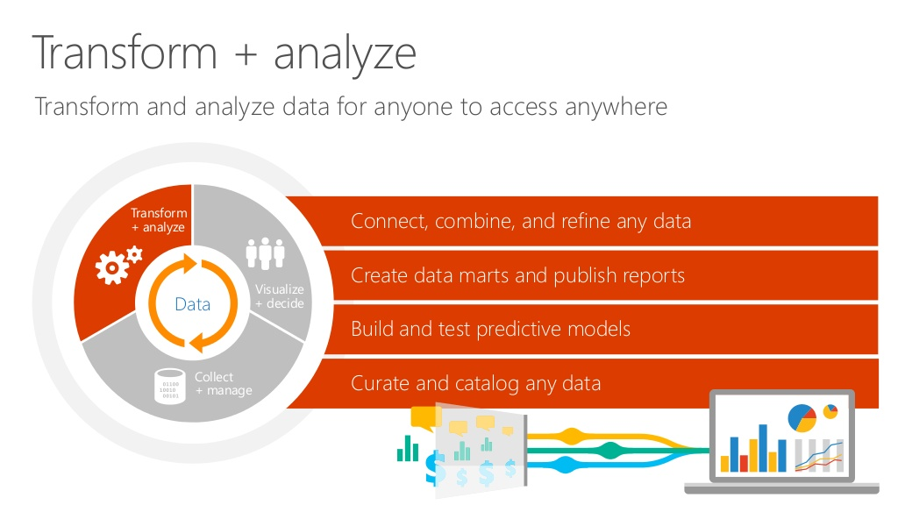

Slide 34
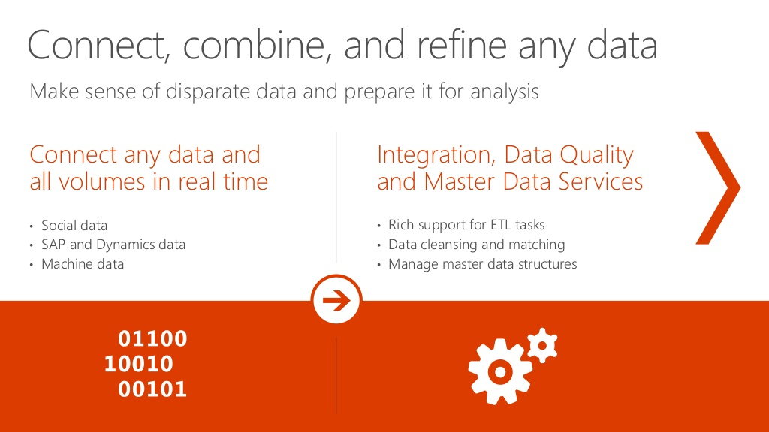

Slide 35
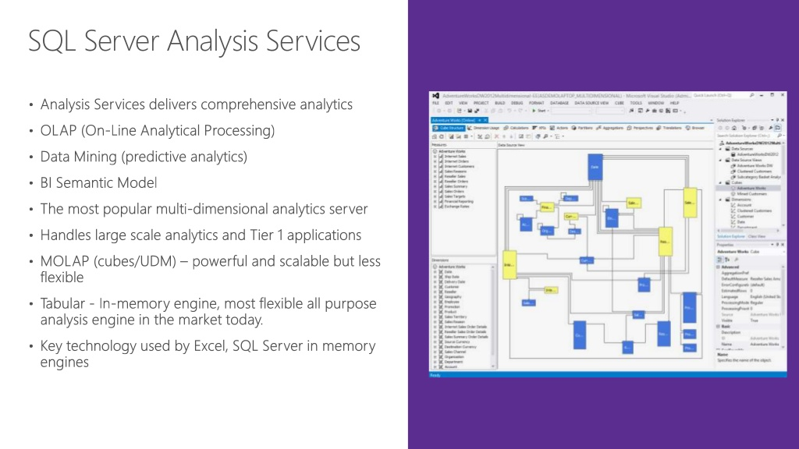

Slide 36
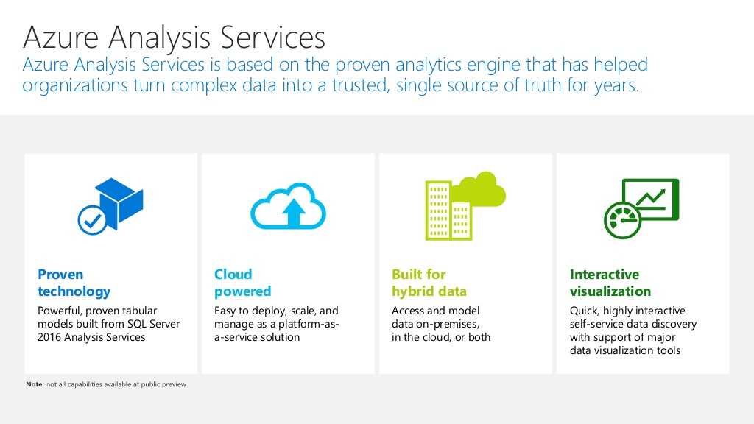

Slide 37
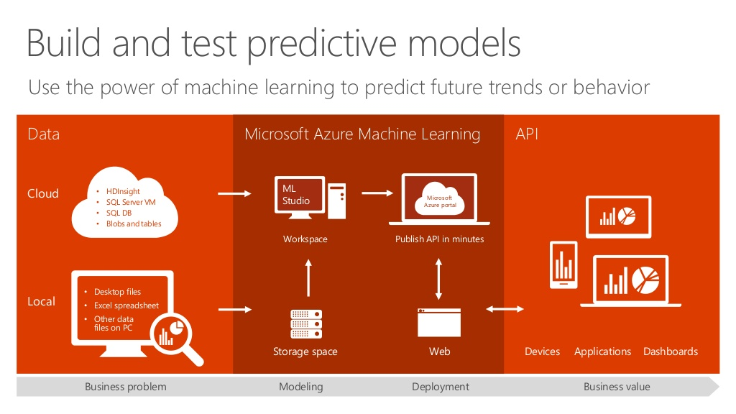

Slide 38
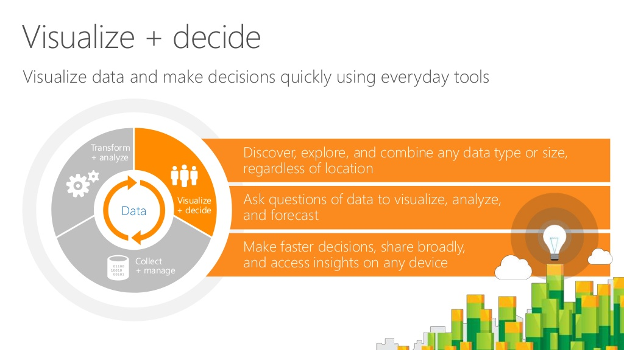

Slide 39
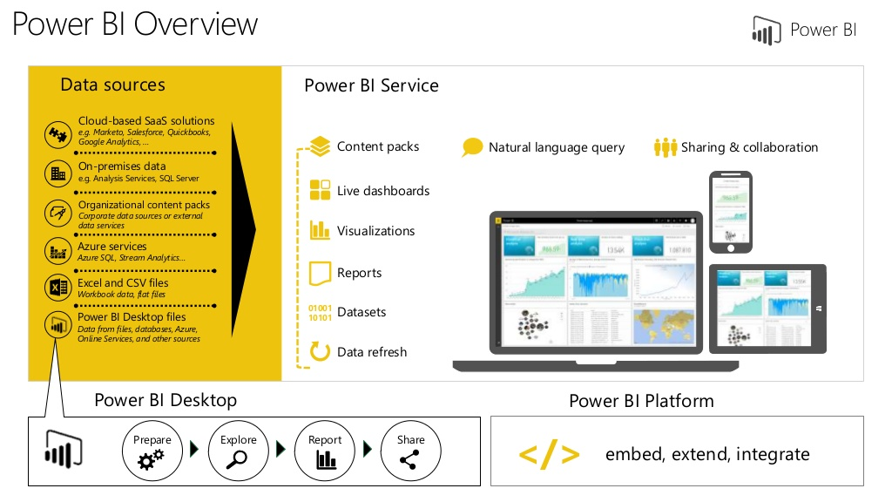

Slide 40
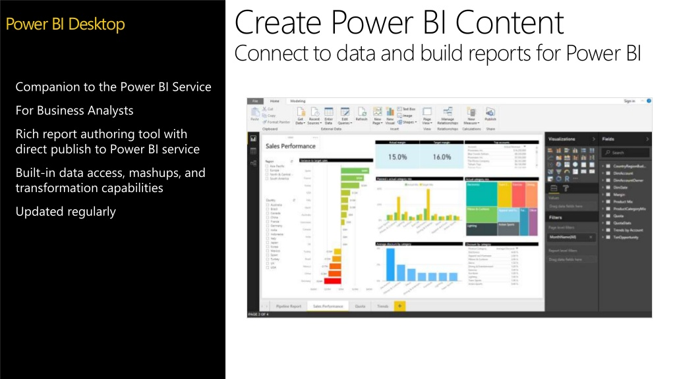

Slide 41

Data modernization on-premises and in the Cloud

Slide 42
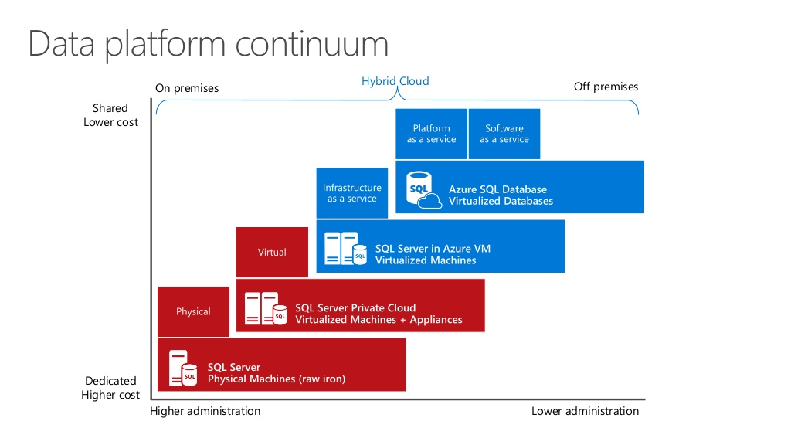

Slide 43
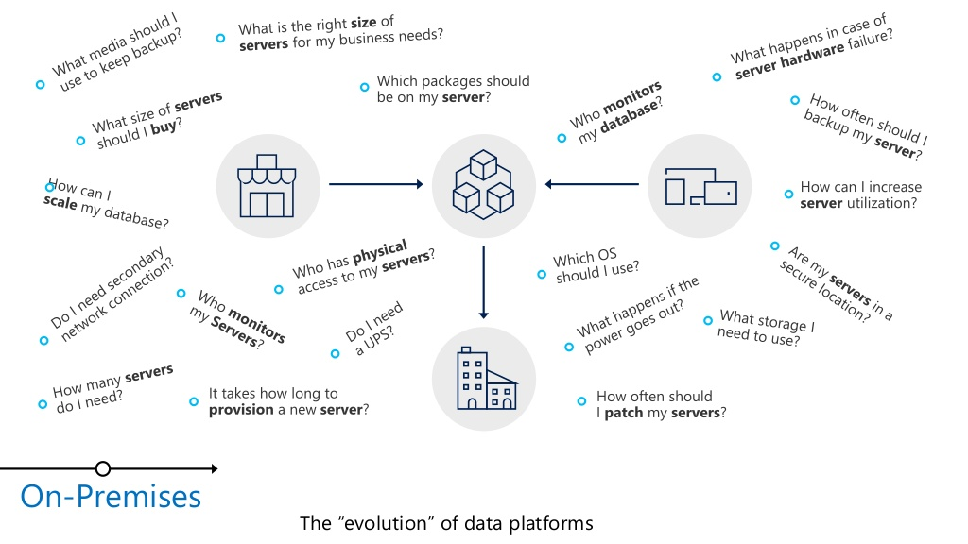

Slide 44
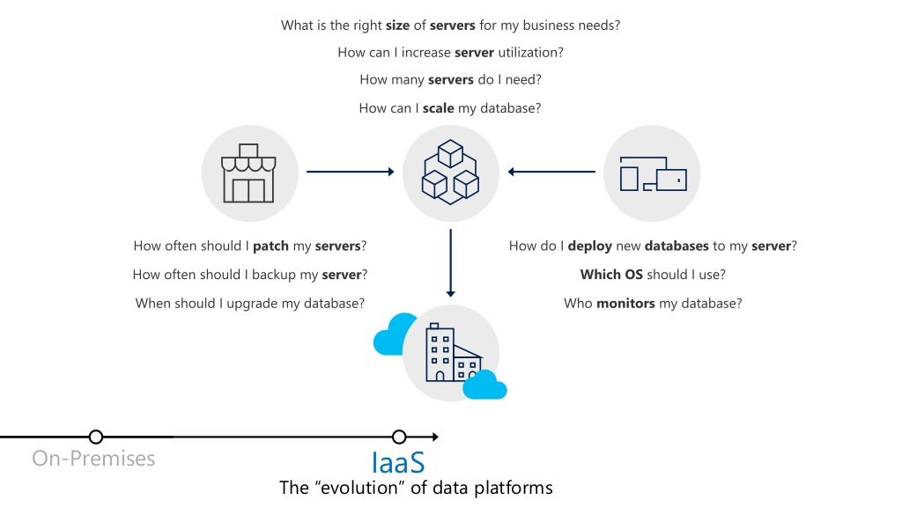

Slide 45
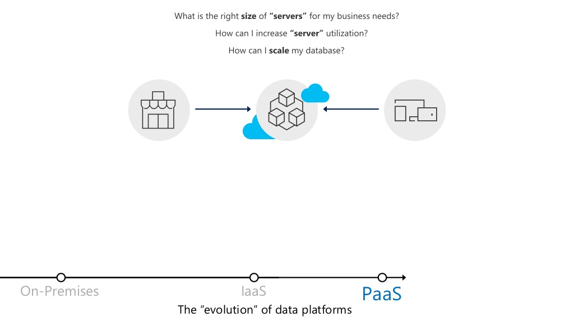

Slide 46
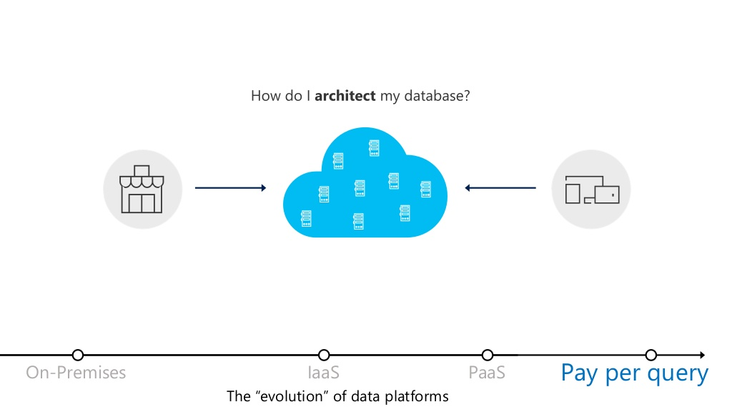

Slide 47
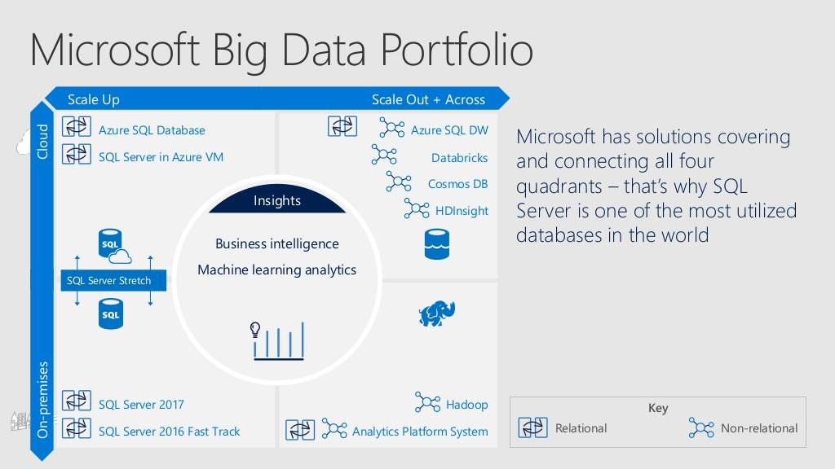

Slide 48
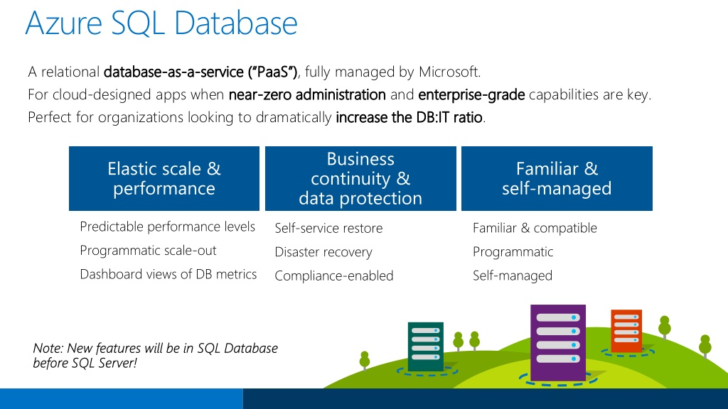

Slide 49
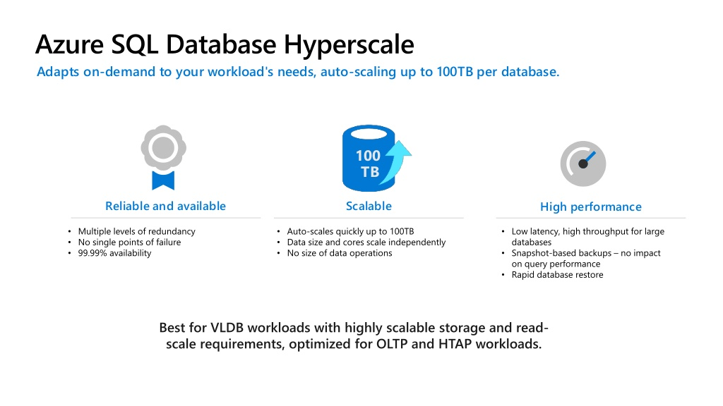

Slide 50
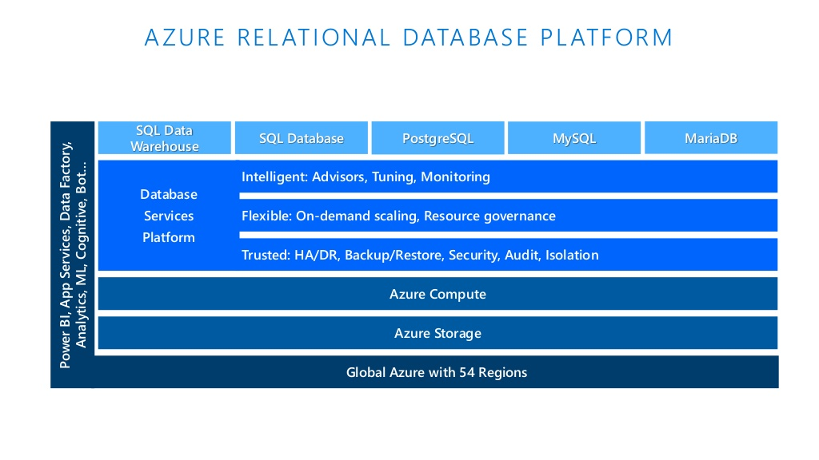

Slide 51
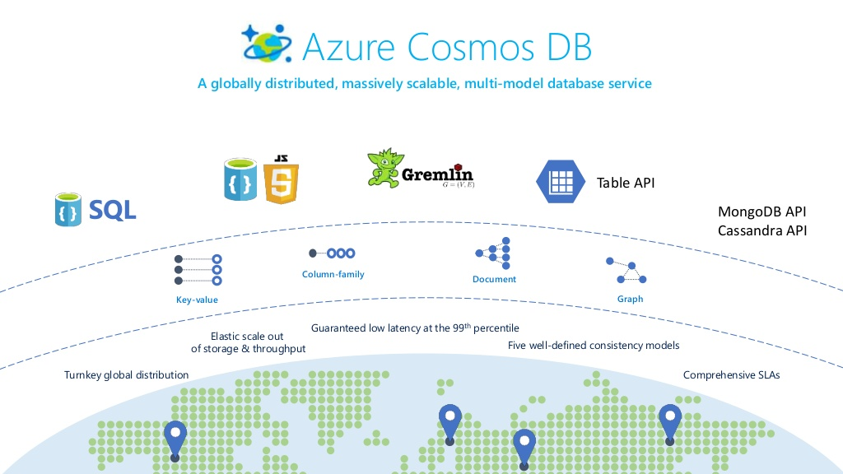

Slide 52
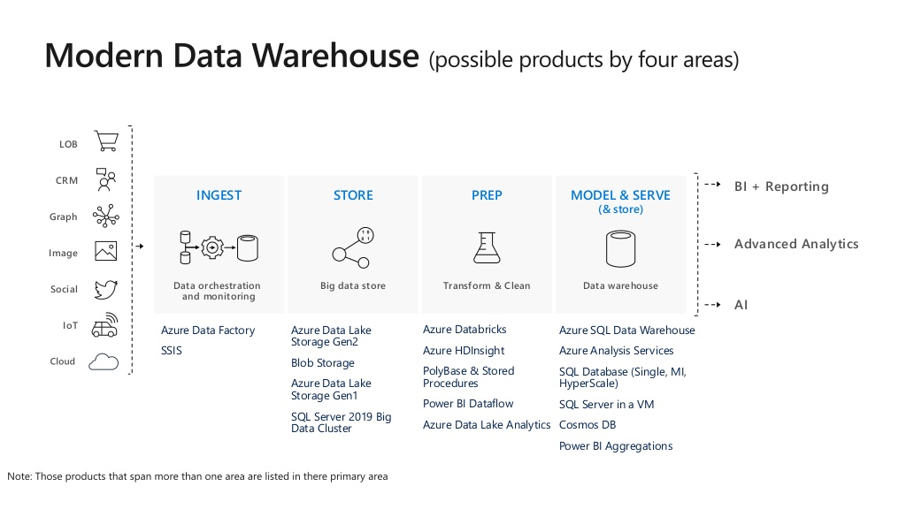

Slide 53
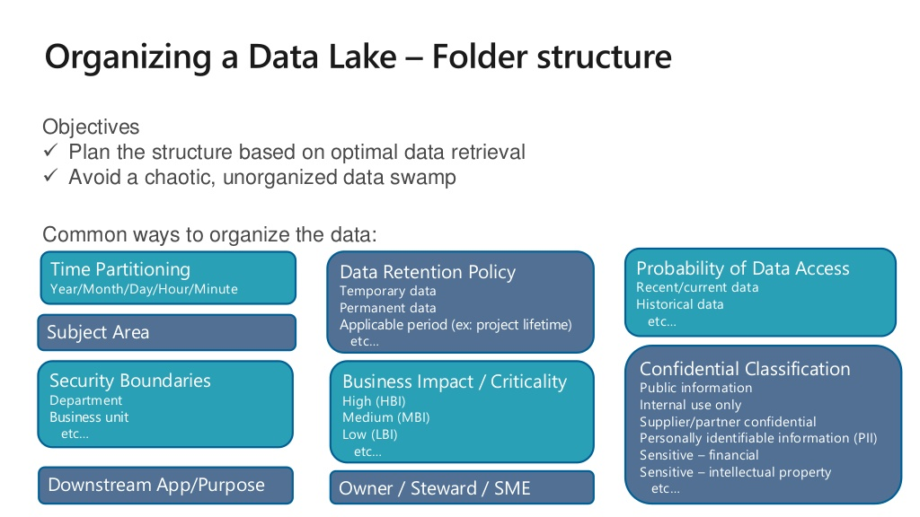

Slide 54
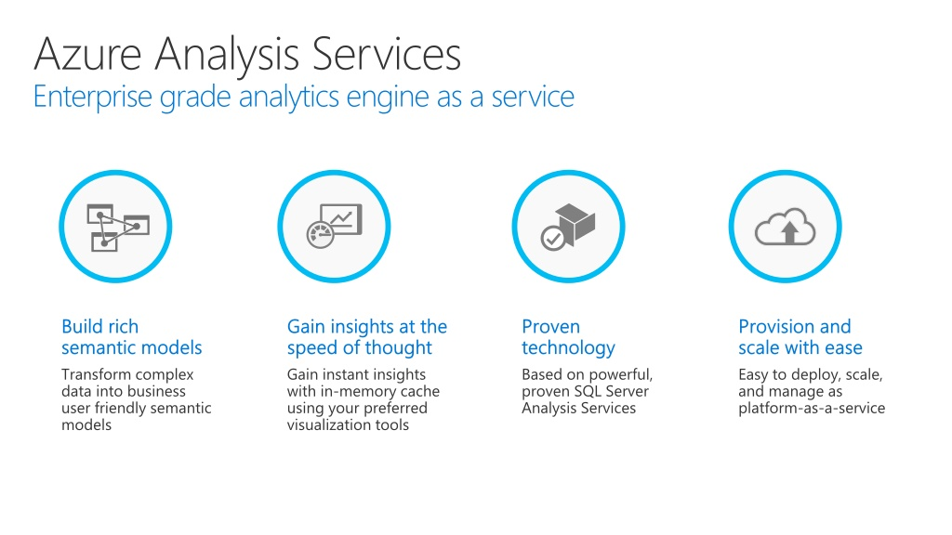

Slide 55
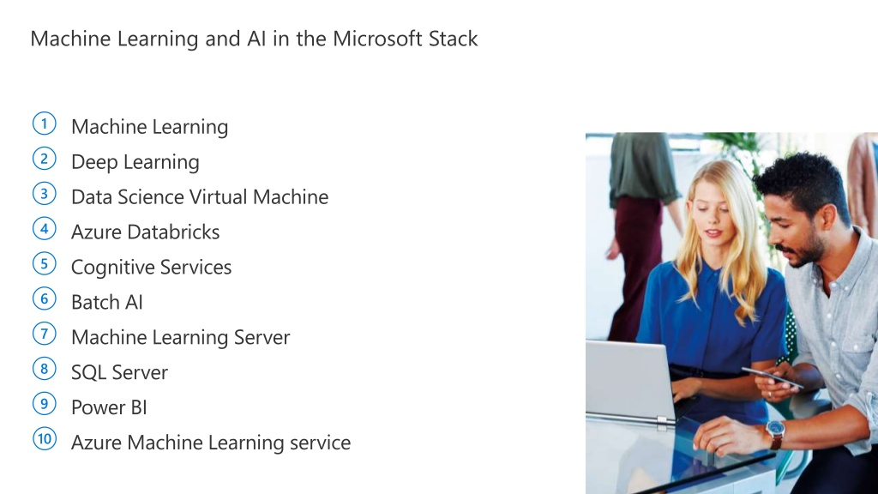

Slide 56
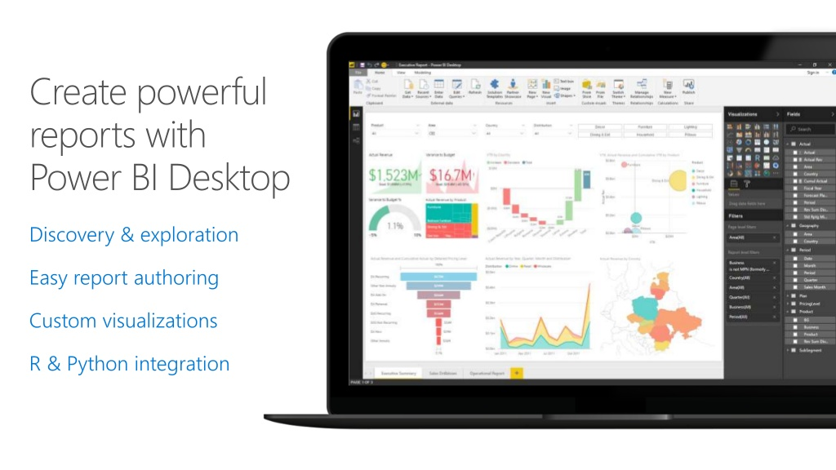

Slide 57
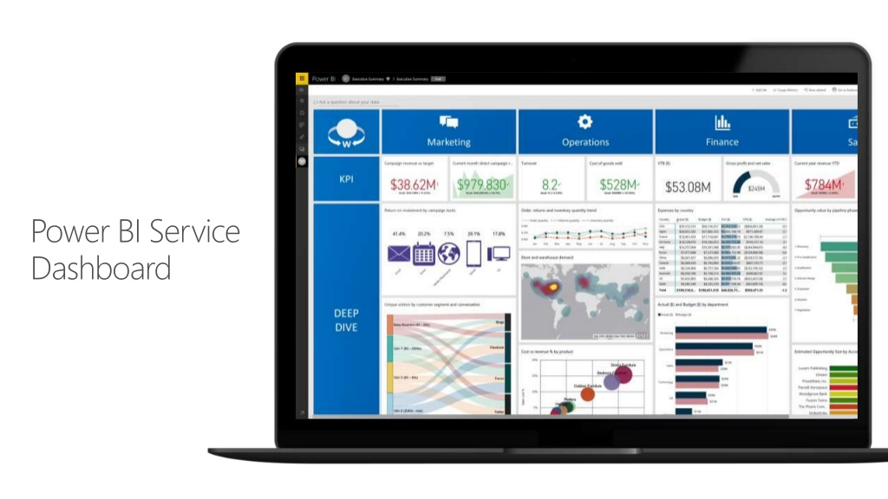

Slide 58

Cloud Scale Analytics
https://www.microsoft.com/azure/partners/cloud-scale-analytics
Notes:
https://www.microsoft.com/azure/partners/cloud-scale-analytics

Slide 59
Barriers to getting value from data
Data silos
Incongruent data types
Performance constraints
Complexity of solutions
Rising costs
Notes:
What prevents companies from capitalizing on that data growth?
Data exists in silos: There are all sorts of data coming in, stored across databases that power the applications or lifeblood of a company, data from sensors and devices, external data sources from media, and more. But harnessing that data is difficult and costly. Furthermore, connecting that data in ways that drives deeper insights poses even greater challenges.
Incongruent data types: Different applications, different data formats. There is tremendous complexity in bringing these formats together in a way where companies can leverage varietal data sources to derive insights that are richer than the single source.
Performance constraints: On-premises systems reach capacity. Customers are having to make strategic decisions about how to scale and how to do it cost effectively.
Complexity of solutions: Over time, companies have adopted a variety of products or solutions to solve specific business needs. They now find that they have a diverse set of tools, on premise and in the cloud, all with their unique tool sets and cost models, and skill sets requires to use them. It is hard to skill up and scale these offerings for the whole company to take advantage of, and costing is no longer transparent…the invoice has many line items to manage.
This comes to rising costs. Scaling up and adding hardware, paying for multiple toolsets that have some overlapping capabilities but lacking the scale, or ubiquity to do more than a purpose driven task well, and hiring resources with the specific skills needed adds up. And suddenly, companies looking to get ahead and maximize ROI with data are finding it challenging to harness it for transformation.

Slide 60
Derive real value from your data
One hub for
all data
Support for diverse types of data
Unlimited
data scale
Familiar tools and ecosystem
Lower TCO
Notes:
To derive real value from your data, msft provides a comprehensive platform with familiar tools and a robust ecosystem of partners and ISVS to deliver the solutions you need.
One hub for all data: This is one of the most significant pain points we hear from customers. How can I get access to all of the data internally and externally to my organization. Each system needs its own database, that is true. Microsoft’s analytics solution is able to connect to those data sources and bring that data into a cloud scale data warehouse solution for deriving insights, from a variety of data sources.
Diverse data types: This data can be in various formats, structured, and unstructured. It doesn’t matter. Microsoft’s solution can process the data into formats that can be leveraged in new and exciting ways.
Unlimited data scale: Not only can Microsoft’s solution process these diverse types of data, it can do it at scale, without constraints typically associated with existing on premises solutions.
Familiar tools and ecosystem: And, you don’t have to hire a number of specialists to manage a niche tool. Microsoft’s offerings provide familiar tools and ecosystem to help you leverage your investment quickly.
Lower TCO: The benefits noted all accrue to a lower TCO.

Slide 61
Big Data and data warehouse
LOB
CRM
Ingest
Store
Prep & train
Model & serve
BI + Reporting
Graph
Advanced Analytics
Image
Social
Data orchestration and monitoring
Big Data
store
Analytics
engines
Data
warehouse
Real Time Analytics
IoT
Cloud
Notes:
Only Microsoft delivers a comprehensive cloud scale analytics solution.
First, you need to be able to ingest data where ever that data is, whatever type of structured, unstructured, streaming data.
Once you’ve ingested this data you need a cloud scale storage solution that can handle all data types at scale and cost effectively.
Once stored data, you want to be able to prepare and process your data, to transform unstructured data and serve it with your structured data into the data warehouse.
Finally, you can leverage that data in a number of ways. Deliver it to the organization with rich visualizations for improved BI and reporting, deliver more advanced analytics such as personalized customer experiences, and access real-time data all at your fingertips for better business outcomes (for example, predictive maintenance).
In this example, we’ve integrated data into a single hub to provide intelligent insights with rich BI, Advanced Analytics, and Real Time analytics to drive the business forward.

Slide 62
Cloud scale analytics
Productive
Hybrid
Intelligent
Trusted
Accelerate time to market
Evolve with your needs
Get insights on any data
Ensure peace of mind
Notes:
Productive: quickly build solutions and focus on biz value:
all the tools and services you need on a single platform, reducing complexity. (familiar tools)
Familiar tools to quickly go to market: example
Provision your data warehouse & spark environment in minutes with a single click
Accelerate your data integration with consistent 70+ native data connectors
Empower your data scientists, data engineers, and business analysts to use the tools and languages of their choice
Hybrid: meet you where you are: cloud is a journey – customers environments on premise and cloud, evolve with your needs.
How we are Hybrid:
Leverage SQL Server’s proven performance and security consistently, in public or private cloud
Reduce cost & complexity of managing your existing data transformations by consistently running SQL Server Integration Service packages in Azure
Enable consistent user experience with common identity across on-premises and Azure
Intelligent: Tools that drive intelligence not only in the cloud but at the edge. You can move your analytics and machine learning closer to your data.
Need more detail
Our customers understand the value the of intelligent cloud and are using it to connect their businesses and customers globally. For certain scenarios, they are also recognizing the need to process and analyze data close to where the data originates. This is the power of intelligent edge. Customers are increasingly packaging applications in containers and deploying them onto their devices themselves, closer to where the data is created. This enables organizations to build machine learning and AI solutions that not only scale out with their needs, but also provide immediate inferences from intelligence built on the edge.
Trusted:
Local availability enables you to be compliant where your data resides. This allows mission-critical work of crucial organizations to take advantage of local availability. This addresses the requirements of governments and national infrastructure, including banks, utilities, transport and telecommunications. We want to ensure that we build our cloud infrastructure to serve the needs of customers by driving innovation and making it accessible globally.
50+ industry and geographical compliances
Azure Active Directory: role based admin control on your data access.
SQL Server & GDPR Compliance

Slide 63
Why cloud scale analytics?
Analytics is critical, not optional
The roadmap to running your business efficiently lies in your data
Remove data silos
Notes:
Today, analytics isn’t a bonus prize; it’s a fundamental requirement. If you
don’t do the work to coalesce and organise your siloed data, you could be
limiting the degree of your success. The roadmap to running your business
efficiently lies in your data, and without analytics you’re neglecting to use
that roadmap and must rely on hunches. Considered in that light, analytics is
critical, not optional.
With analytics, your business is organised, competitive and optimised and
you can make decisions with greater confidence and conviction. That can
make your organisation more proactive. You’ll be more willing to verify your
hunches and intuitions and the trepidation you may have around making
changes can decrease.
Analytics helps you answer the questions you were afraid to ask. And the fear in asking those questions will dissipate,
because you’ll have confidence in determining an answer. You won’t just find out what things might be going wrong;
you’ll also figure out how to make them go right.
You’ve collected and maintained your data. Why not go the last step and analyse it? Insights gained from this
analysis can make your organisation more efficient, more competitive, more valuable and more in control. Taken
from that perspective, analytics and especially cloud scale analytics, is a must-do.

Slide 64
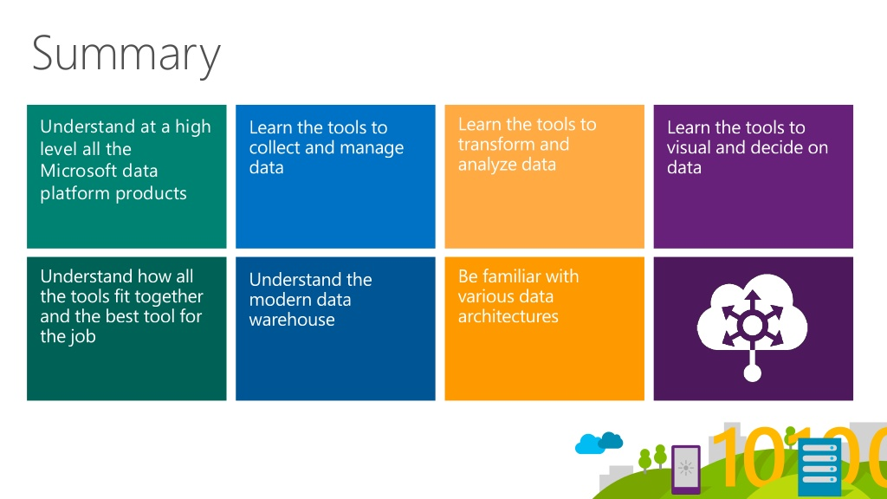
Notes:
Microsoft also offers a variety of learning resources, both formal and informal, that can make the hands-on
experience more productive and fun. And for those who wish to explore Microsoft’s cloud scale analytics
services further before getting hands-on, a number of additional overview resources are available.
We’ve looked at the what and why of cloud-scale analytics, and
we’ve seen how analytics service building blocks – including data
warehouse, data lake, BI, data virtualisation, storage, integration,
governance and AI – work together to make it a reality.
Microsoft offers a variety of cloud scale analytics services that
leverage the best of open source and Microsoft’s unique data
platform technology. Sometimes, such a broad array of options can
be a little intimidating; the best antidote is to get hands-on with one
or two of the technologies, then branch out further. Microsoft Azure
offers a free tier that lets customers do just that; Power BI Desktop
is available as a free download and the Power BI service offers a free
subscription level.

Slide 65
STEFANO TEMPESTA
/in/stefanotempesta
@stefanotempesta

